Slide 1







Slide 2

Visual Studio
Те, що ви не знали

Slide 3
facebook.com/
twitter.com/
devTaras
linkedin.com/in/devtarasin/
Тарас Середоха
N-iX
SoftServe

Slide 4

Сьогодні в програмі
Тут могла бути програма доповіді, але на це не вистачало часу ☺

Slide 5
Сімейство Visual Studio®
Visual Studio
Visual Studio for Mac
Visual Studio Code
Visual Studio Mobile Center
Visual Studio Team Services

Slide 6

Why Java developers wear glasses? They can’t see sharp

Slide 7

Частина 1
Visual Studio Unused features

Slide 8
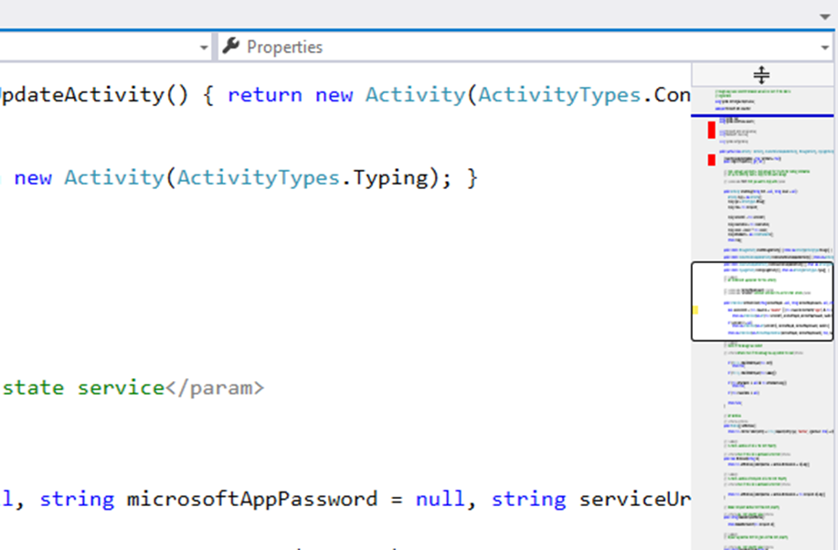
Map Mode

Slide 9
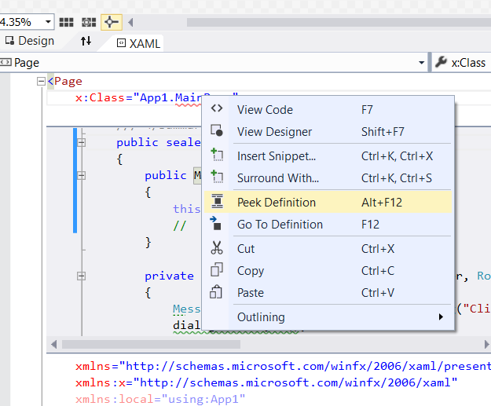
Peek definition (Alt+F12)

Slide 10
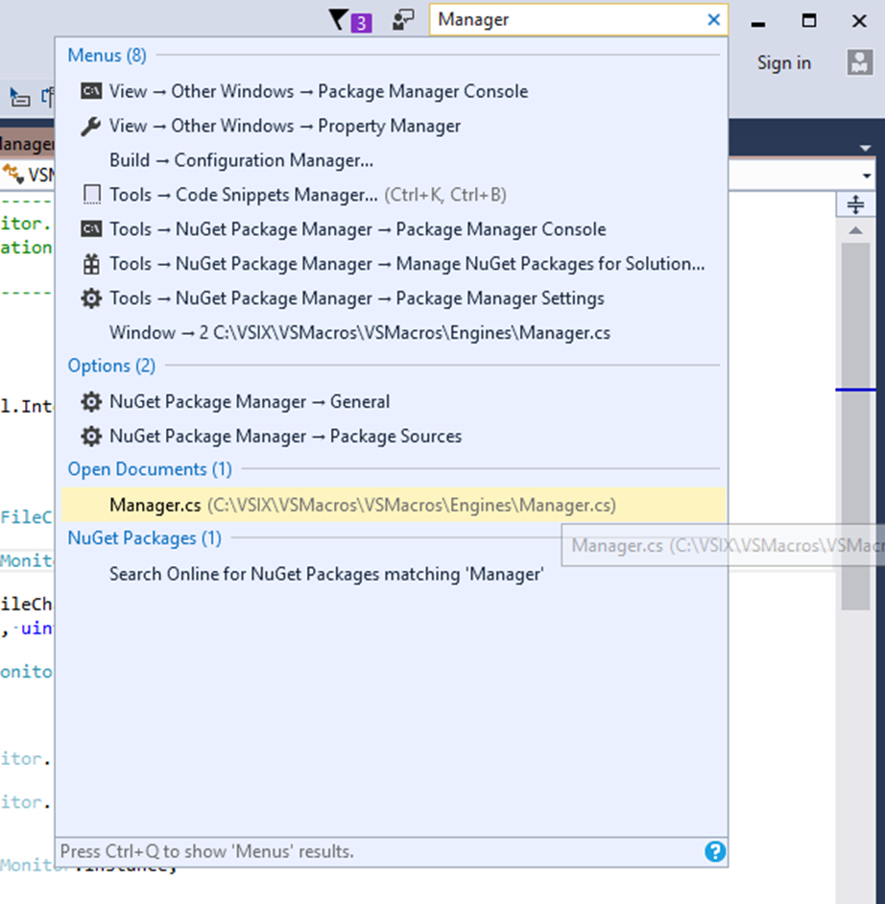
Quick Launch (Ctrl+Q)

Slide 11
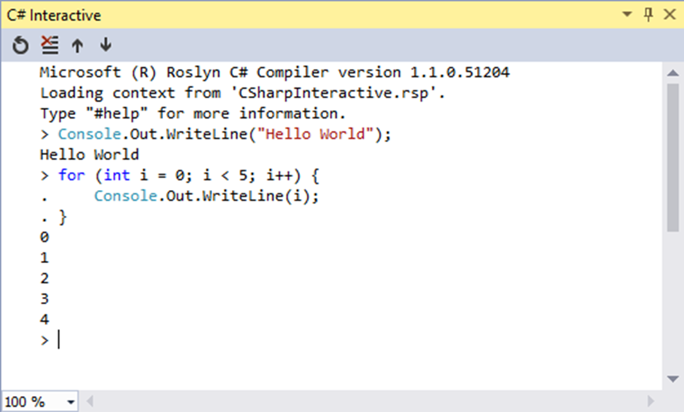
C# Interactive window (REPL)

Slide 12
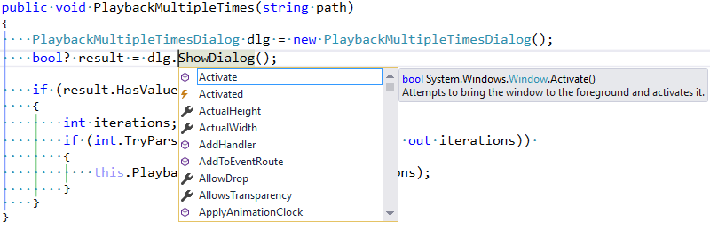
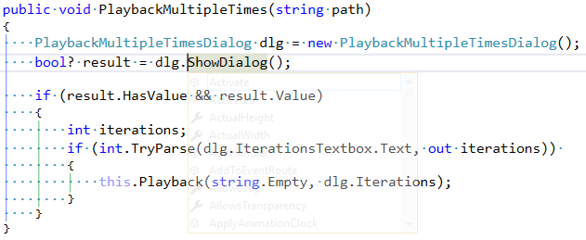
Transparent pop-up boxes (Hold the Ctrl key)

Slide 13
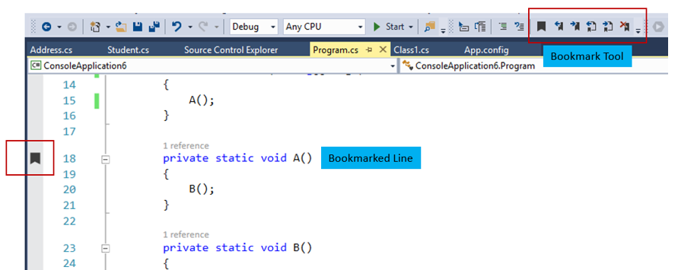
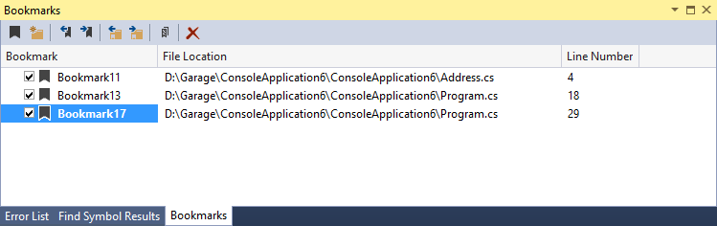
Bookmarking
Ctrl+B+T or select the “Toggle a bookmark in current line”

Slide 14
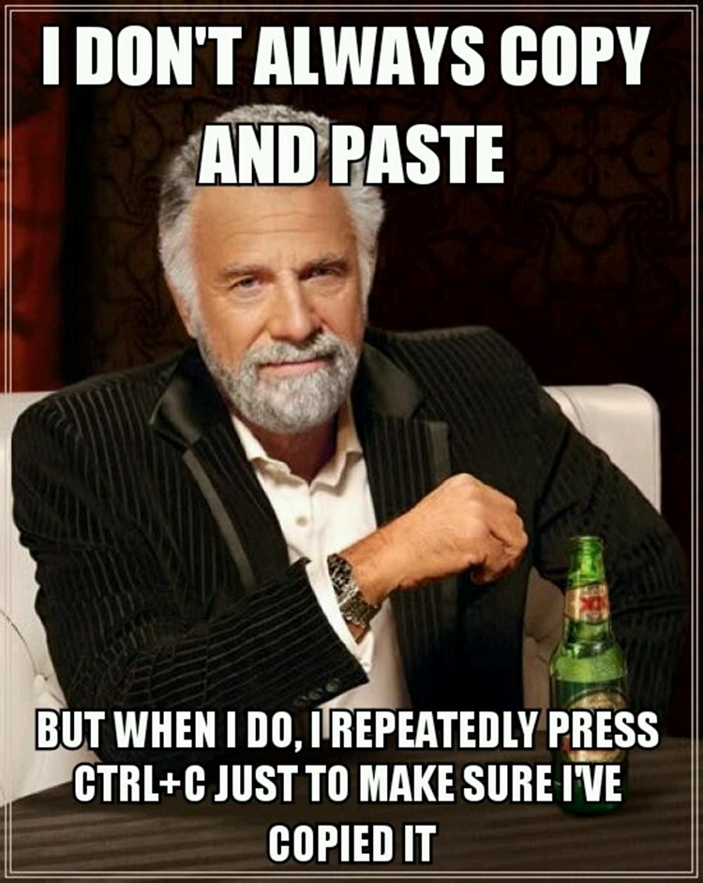
Clipboard Ring
Up to 15 text blocks
Ctrl+C / Ctrl+X
Ctrl+Shift+V

Slide 15
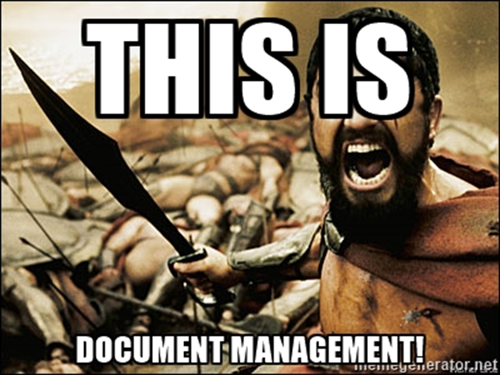
Sync with Active Document
Sync with Active Document
How To Track it Automatically ?

Slide 16
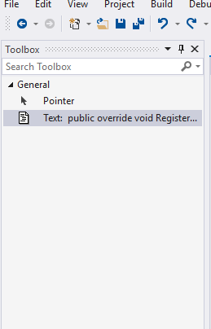
Toolbox for code
Use Visual Studio Toolbox as place for reusable code

Slide 17
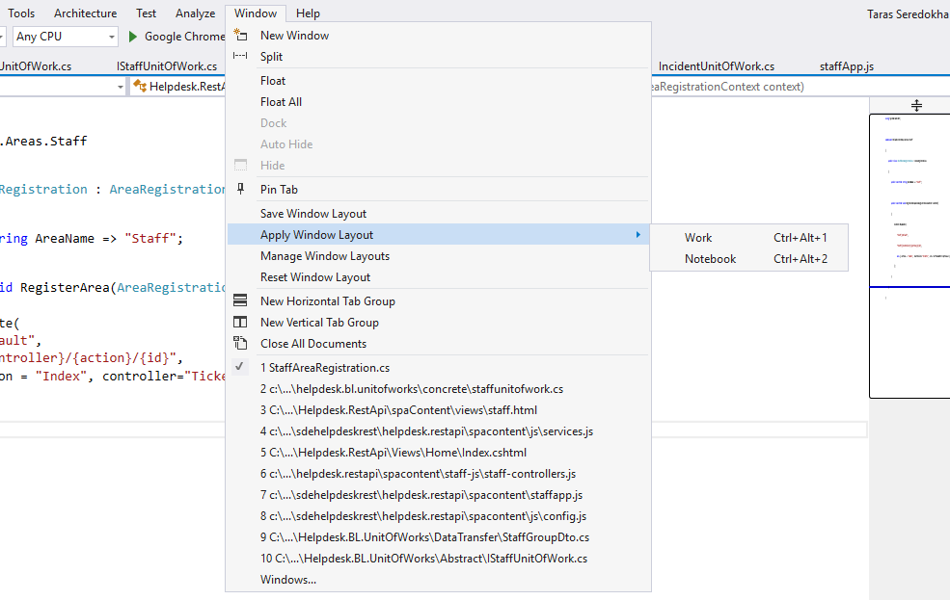
Custom Windows Layouts
Create
Manage
Apply

Slide 18
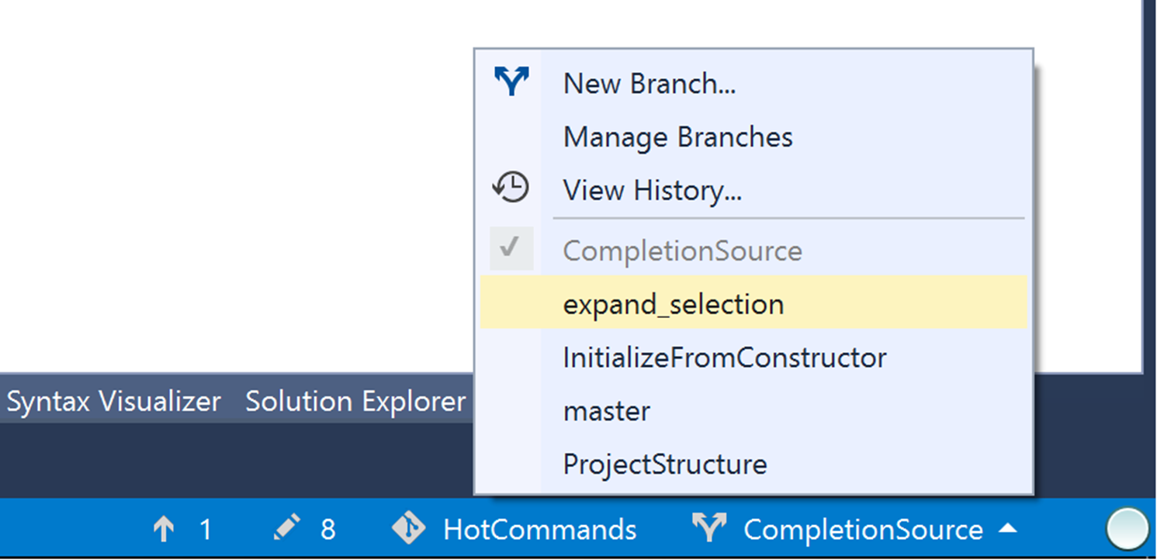
Git info in status bar

Slide 19
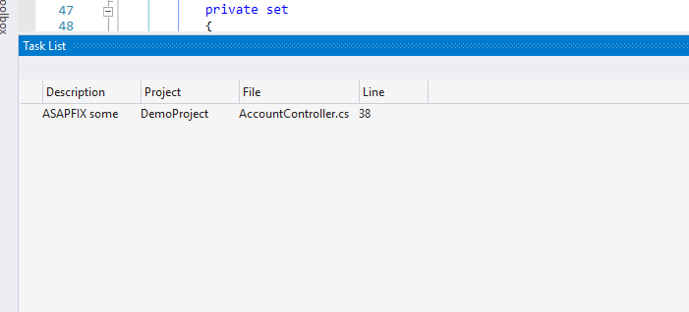
Task List & Task Tokens
Prioritize tasks
Using custom tokens

Slide 20
Sign in to Visual Studio
Grants access to a broad range of benefits from the Visual Studio Dev Essentials program
Synchronizes your Visual Studio settings
Extends the Visual Studio trial period
Unlocks Visual Studio if you use an account that's associated with an MSDN or VSO subscription.
Automatically connects to services such as Azure and Visual Studio Team Services in the IDE without prompting again for credentials for the same account.

Slide 21

Частина 2
Visual Studio Must know features

Slide 22
Live Dependency Validation
Invalid Dependency
Invalid namespace name
Dependency on unreferenceable namespace
Disallowed namespace name

Slide 23
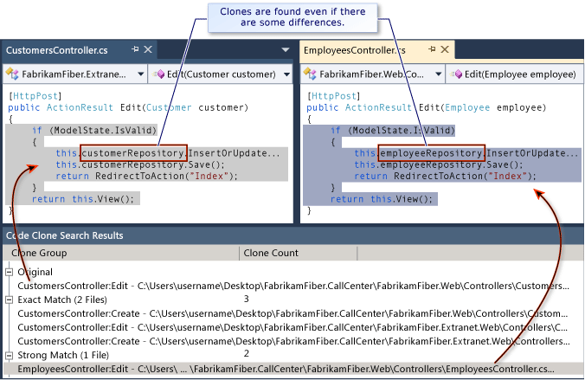
Code Clone Detection

Slide 24

Частина 3
Visual Studio Extensions

Slide 25
Productivity Power Tools 2017
Peek Help
Solution Error Visualizer
Structure Visualizer
Double click to maximize windows
Timestamp margin
Quick tasks – Edit Present On
Ctrl + Click to Peek Definition / Go To Definition
Recently Closed Documents
Match Margin
Power Commands context menu
Syntactic Line Compression
Quick Tasks
Power Commands
Middle-Click Scrolling
Custom Document Well
Match Margin
Tools Options Support
HTML Copy
Fix Mixed Tabs
Align Assignments
Align Assignments
Column Guides

Slide 26
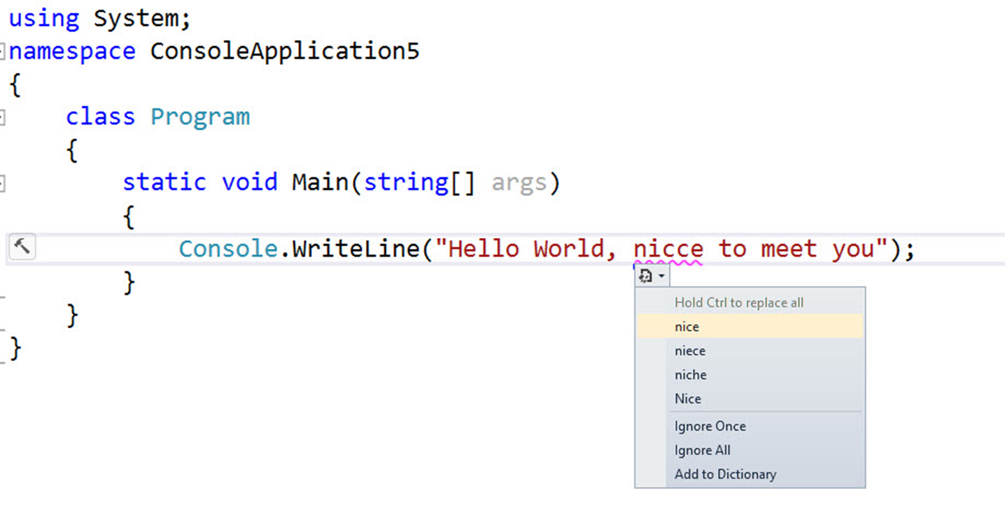
Visual Studio Spell Checker

Slide 27

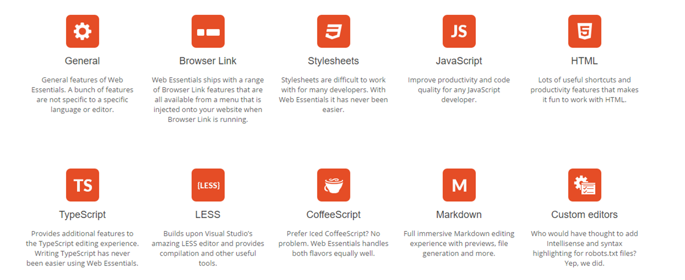
Web Essentials 2017

Slide 28
Web Extension Pack
Add New File
Browser Reload on Save
Browser Sync
Bundler & Minifier
Editor Enhancements
File Icons
File Nesting
Glyphfriend
HTML Snippet Pack
Image Sprites
Image Optimizer
JavaScript Snippet Pack
Markdown Editor
Open Command Line
Package Installer
Suggested Extensions
Web Accessibility Checker
Web Compiler
Web Essentials 2015

Slide 29

Suggested Extensions
Suggested extensions
Suggest missing extensions for unknown files
Installs missing extensions easily
Show a list of generally suggested extension
Solution specific extensions
The .vsext file
Intellisense

Slide 30
jQuery Code Snippets
This one is pretty self explanatory, it extends the Visual Studio jQuery snippets, and you don't need to spend your time typing $.ajax and what comes after it, it makes your jQuery coding speed a lot faster.

Slide 31
Bootstrap Snippet Pack
The same thing as jQuery snippet, but this time it's for Bootstrap, it makes your life a lot easier and you don't have to look for examples on the web anymore, just type "<bs-Something" and you're good to go.

Slide 32

Ref12
Microsoft recently launched a browsable version of the .Net reference source code at http://referencesource-beta.microsoft.com.
This extension lets you press F12 to open the source code for anything in the .Net framework.

Slide 33
Code Cracker for C#
An analyzer library for C# that uses Roslyn to produce refactoring's, code analysis, and other niceties. Check the official project site on
code-cracker.github.io. Build status Nuget count Nuget downloads Issues open This is a community project, free and open source.

Slide 34
Частина 3
Visual Studio & Azure

Slide 35
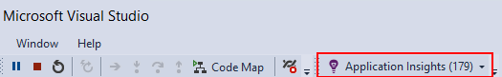
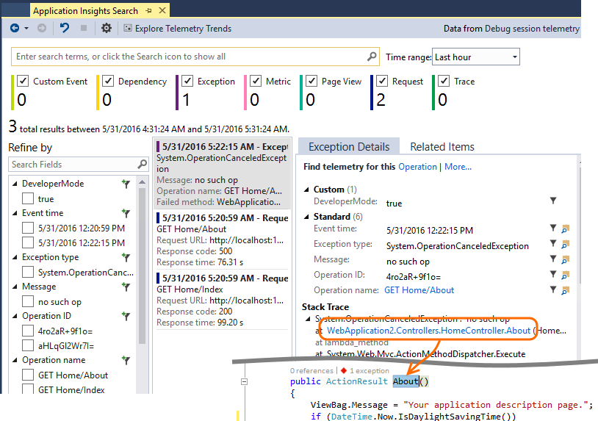
Application Insights

Slide 36
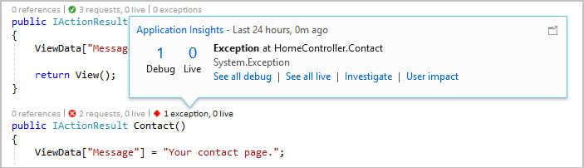
View request and exception summaries in the code

Slide 37
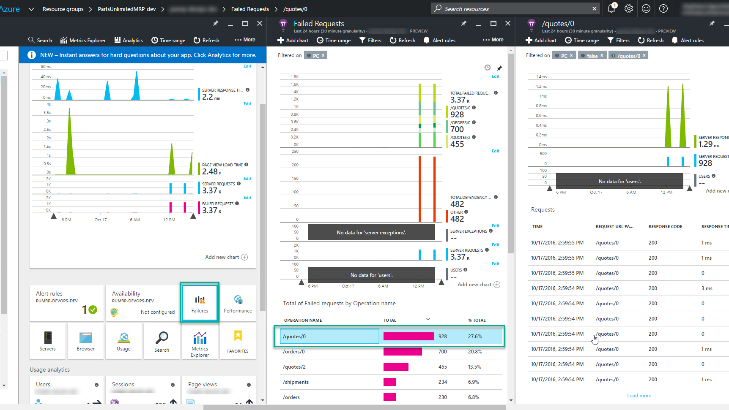

Slide 38
Питання
Відповіді

